Slide 1
Exploring Language Models for Query-Document Relevance Prediction on the QBQTC Dataset
CS5242 Group 6
Dong Suhong, Li Han, Li Junfeng, Wang Yifei, Wang Hao

Slide 2
Introduction
01
Background
Predicting relevance between a user query and a document title is critical for improving web search and information retrieval systems.
Problems Definition
Goal: Predict the relevance level (Poor, Moderate, High) between a query and a document title.
Challenge: Capture subtle semantic relationships and contextual cues from short text pairs.
Approach: Compare different neural architectures to identify the most effective model for relevance prediction.
Dataset: QQ Browser Query Title Corpus(QBQTC)

Slide 3
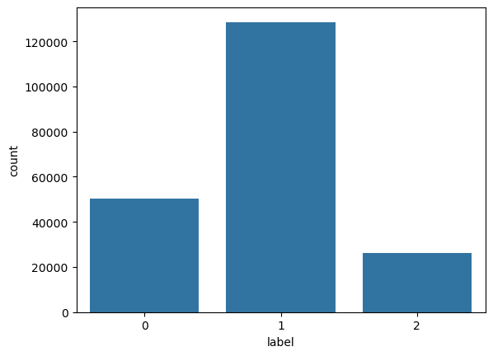
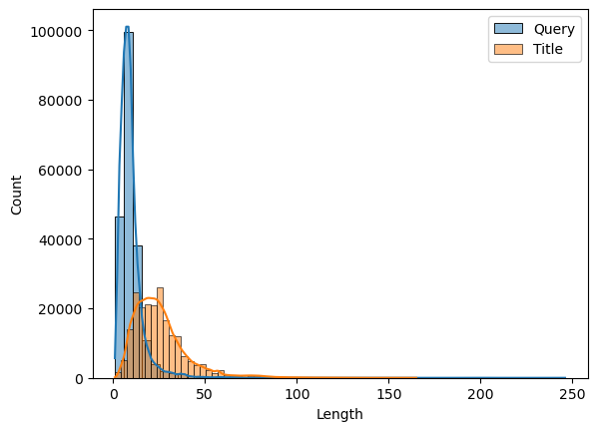
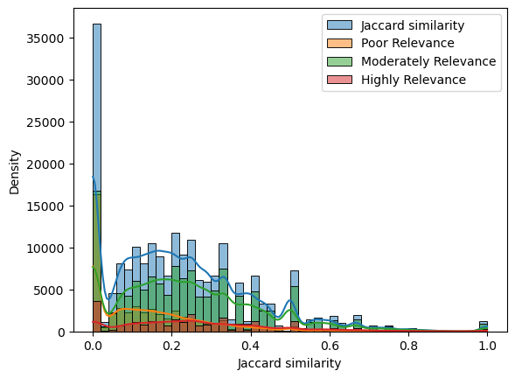
02
EDA
Distribution of Labels
Unbalanced dataset
The number of Label1 is about twice that of the others
Distribution of Document Lengths
Query averages around 9.6 words
Title averages around 25.4 words
But some are extremely long
Overlap between query and title
No strong or consistent patterns
No word-level method
Highline the challenge of this dataset

Slide 4
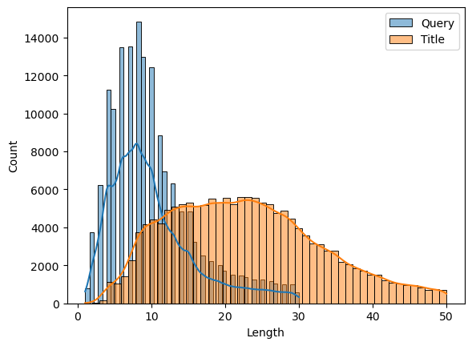
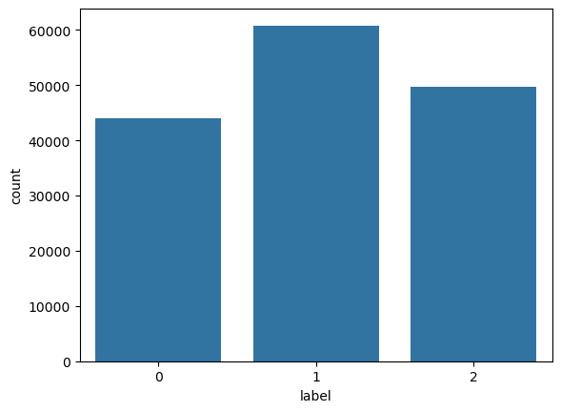
03
Pre-processing
Filtering out the Outliers
Query Length: 30 characters
Title Length: 50 characters
Sampling of the training data via LLMs
Drop 50% of the data with Lable1
Use the LLM to rephrase all the data with Label2

Slide 5
04
Model Module - MLP
Vocabulary Building and Text Encoding
Vocabulary Construction
Count word frequencies across training and development data.
Build vocabulary with a maximum size of 10,000 words.
Reserve special tokens `<pad>` and `<unk>`.
Text Encoding
Concatenate `query` and `title` for each sample.
Map words to vocabulary indices.
Pad short sequences to a minimum length if needed.
Embedding Initialization
Embedding Matrix
Size: `(vocab_size, 100)`.
Initialization: Random normal distribution (`mean=0`, `std=0.6`).
Reserve special tokens `<pad>` and `<unk>`.
Embedding Layer
Load the embedding matrix into a non-trainable `nn.Embedding` layer.

Slide 6
04
Model Module - MLP
MLP Model Architecture
Input
Encoded sequence of token IDs.
Embedding Layer
Maps token IDs to 100-dimensional vectors.
Mean Pooling
Averages all token embeddings into a fixed-length vector.
MLP Layers
2 hidden layers
Linear (100 → 128) + ReLU
Linear (128 → 128) + ReLU
Output Layer
Linear (128 → 3 classes)
Loss Function
CrossEntropyLoss
Training Details
Optimizer: Adam (learning rate = 1e-3)
Batch Size: 64
Epochs: 5
Device: GPU if available, else CPU
Validation:
Evaluate model performance on the
development set after each epoch.
Metrics: Accuracy and Classification Report
(Precision, Recall, F1-score).

Slide 7
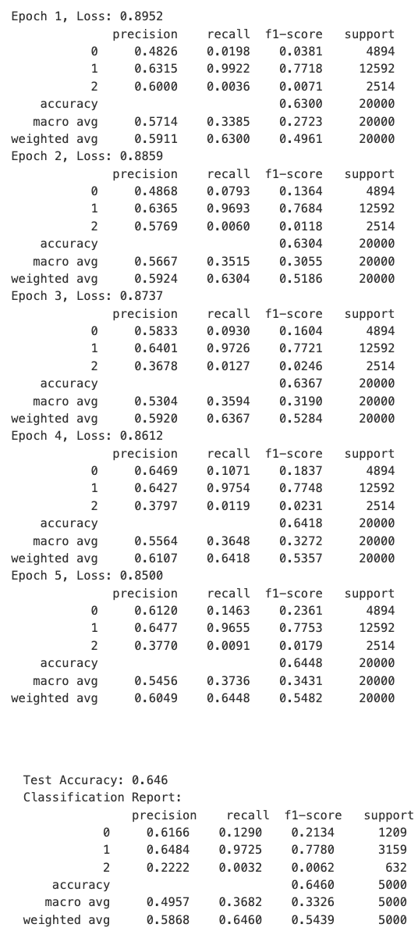
Model Module - MLP
During training, the MLP model demonstrated gradual loss reduction and validation accuracy improvement from 63.0% to 64.5% over 5 epochs. On the test set, the model achieved 64.6% accuracy. It performed strongly on Label 1, achieving precision around 64.8% and recall over 97%, but struggled with Label 0 (precision 61.7%, recall 12.9%) and Label 2 (precision 22.2%, recall 0.32%), indicating a significant class imbalance that affected the prediction of minority classes.

Slide 8
Model Module - CNN
Vocabulary Building and Text Encoding
Vocabulary Construction:
Build vocabulary with a maximum size of 10,000.
Include `<pad>` and `<unk>` special tokens.
Text Encoding:
Combine `query` and `title` fields.
Encode text into token indices.
Pad sequences to a minimum length if necessary.
Embedding Initialization
Embedding Matrix:
Size: `(vocab_size, 100)`
Random normal initialization (mean = 0, std = 0.1).
Embedding Layer:
Load embedding matrix into an `nn.Embedding` layer (non-trainable).
TextCNN Model Architecture
Input: Sequence of token IDs.
Embedding Layer: Converts tokens into dense vectors.
Convolution Layers:
Multiple Conv2D layers with kernel sizes 3, 4, and 5.
ReLU activation + MaxPooling for each convolution output.
Concatenation:
Combine features from different kernel sizes.
Dropout Layer:
Dropout probability 0.5 to prevent overfitting.
Fully Connected Layer:
Maps concatenated features to 3 output classes.

Slide 9
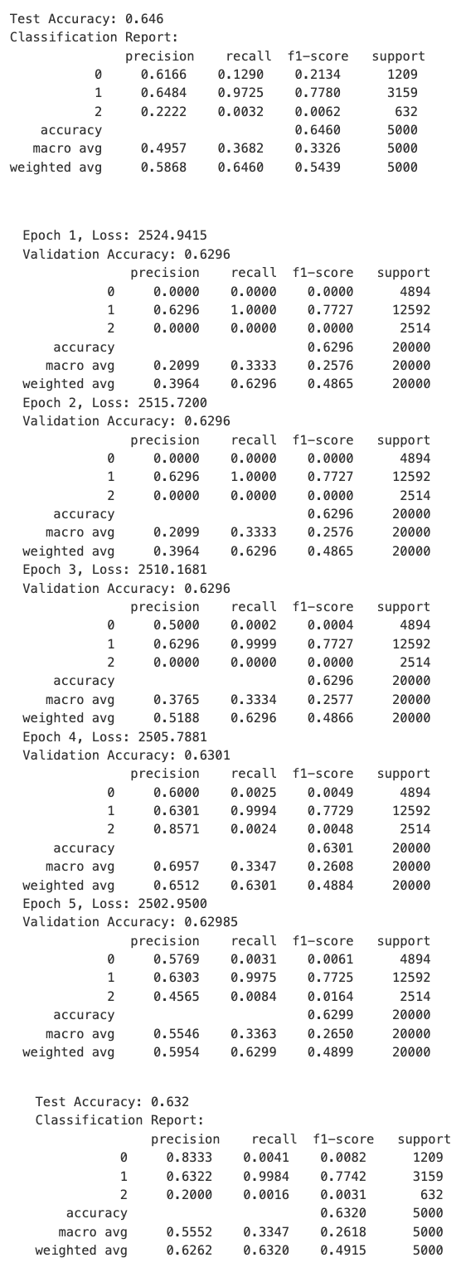
Model Module - CNN
Training Details
Optimizer: Adam (learning rate = 1e-3)
Loss Function: CrossEntropyLoss
Batch Size: 64
Epochs: 5
Device: GPU if available, otherwise CPU
Validation:
Evaluate after each epoch using validation set.
Report accuracy and classification metrics.
During training, the TextCNN model showed slight loss reduction while maintaining a stable validation accuracy of around 63.0% over 5 epochs. On the test set, the model achieved 63.2% accuracy. It performed strongly on Label 1, with high precision (~63%) and extremely high recall (~99.8%), but struggled with Label 0 and Label 2, showing very low recall rates (~0.4% and ~0.16% respectively), highlighting significant class imbalance issues in the dataset.

Slide 10
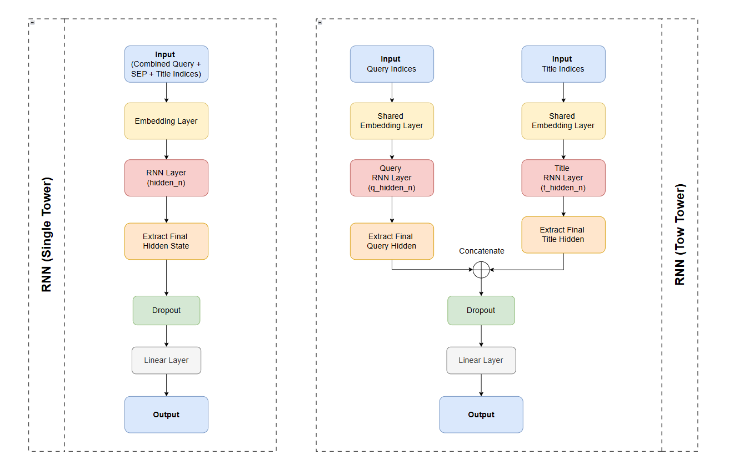
Model Module - RNN
01
SingleTowerRNN merges two input texts (e.g., query and title) into one sequence, processes it with a single RNN to capture early interactions, and outputs the result through a fully connected layer.
TwoTowerRNN builds separate RNN towers for each input (with shared embeddings), independently encodes them, then concatenates their representations for relevance prediction, emphasizing independent understanding before interaction.

Slide 11
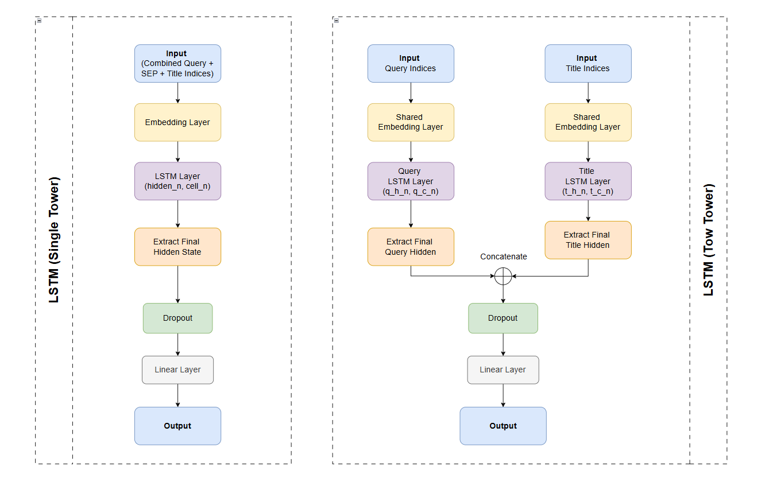
Model Module - LSTM
01
Compared to basic RNN models, models using LSTM are generally more effective at handling longer text sequences and capturing long-range dependencies.
Similar to the single-tower and two-tower modes of RNN, SingleTowerLSTM merges the inputs and uses a single LSTM to capture early interactions, while TwoTowerLSTM encodes them separately and concatenates the representations for relevance prediction.

Slide 12
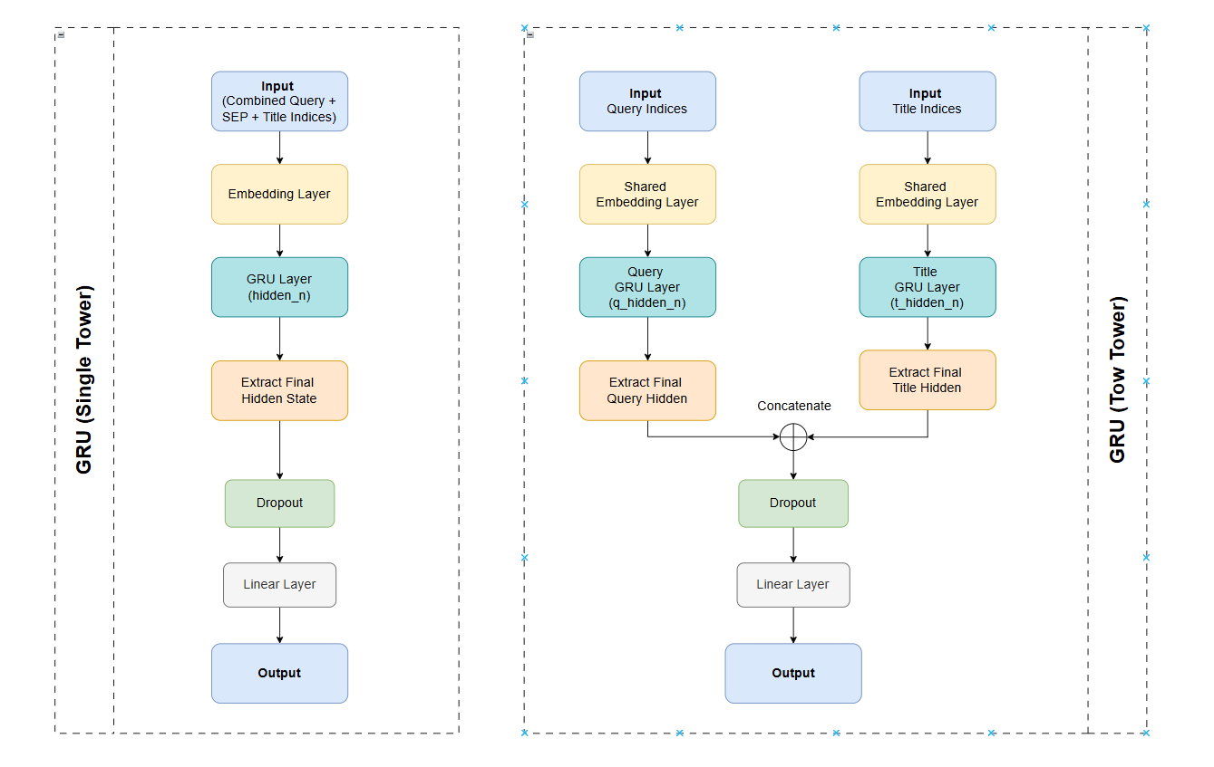
Model Module - GRU
01
GRU's performance is often comparable to LSTM, but due to its simpler structure and fewer parameters, it might offer advantages in training speed and memory consumption.
Similarly, SingleTowerGRU merges the inputs and uses a single GRU to capture interactions, while TwoTowerGRU encodes them separately and concatenates the representations for relevance prediction.

Slide 13
04
Evaluation- RNN LSTM GRU
Model | Accuracy | F1 Score
Single Tower RNN | 0.6440 | 0.6167
Two Tower RNN | 0.6562 | 0.6277
Single Tower LSTM | 0.6634 | 0.6487
Two Tower LSTM | 0.6646 | 0.6434
Single Tower GRU | 0.6640 | 0.6497
Two Tower GRU | 0.6708 | 0.6533
Models using LSTM or GRU generally outperform the base RNN model.
The dual-tower GRU model achieves the highest accuracy (0.6708) and F1 score (0.6533) among all tested architectures.

Slide 14
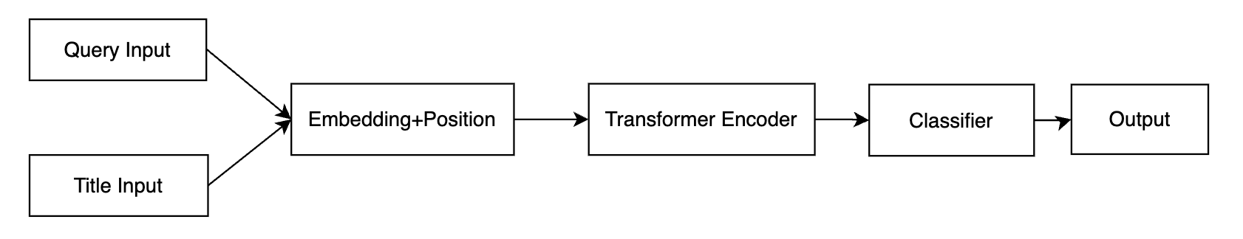
04
Model Module - Transformer
Input Representation
Query and title sequences split into individual characters
Token IDs mapped to 128-dimensional dense vectors
Learnable position encodings capture sequential structure
Sum of word and positional embeddings
Transformer Encoder
Layers: 3
Multi-head attention: 8
Feed-forward network: 4×embed_dim
Layer normalization and residual connections
Classification
Only first token's hidden state used
Linear—ReLU—Dropout----Linear
3 output classes
Test Set Accuracy: 0.6588
Test Set F1 Score: 0.6277

Slide 15
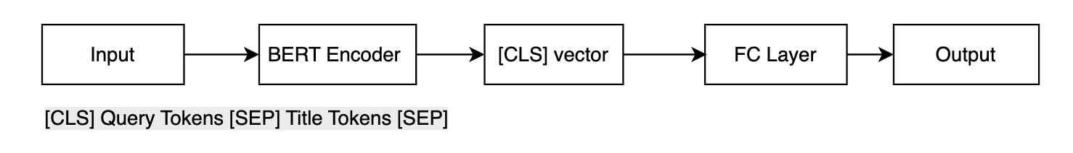
04
Model Module - BERT-based Single Tower
We use BertTokenizer to process input text, converting queries and titles into token sequences that BERT can understand, including adding special tokens [CLS] and [SEP], as well as generating attention masks.
We adopt the BertForSequenceClassification architecture for fine-tuning, setting the classification head to 3 categories corresponding to different matching levels. This fine-tuning approach allows us to retain BERT's powerful semantic understanding capabilities while optimizing for our specific task.
Optimizer: AdamW + learning rate warmup
Training parameters: Batch size 64, learning rate 2e-5
Test Set Accuracy: 0.7408
Test Set F1 Score: 0.7345

Slide 16
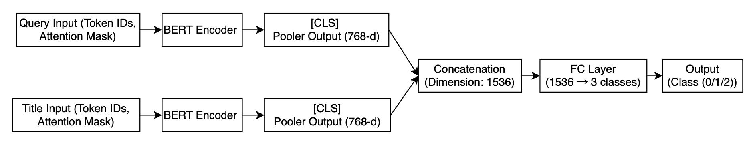
04
Model Module - BERT-based Dual-Tower
This model adopts a dual-tower architecture, utilizing two independent BERT encoders to process query and title texts separately. The key distinction from traditional single-tower models is that we no longer concatenate the query and title before inputting to BERT; instead, we allow them to pass through independent encoders, resulting in two independent representation vectors. These vectors are then concatenated and passed through a linear classifier for final classification prediction.
During training, we use the AdamW optimizer with a learning rate of 2e-5, combined with a learning rate warmup strategy, completing model training within 3 epochs. We also use the F1 score as our evaluation metric and save the best-performing model.
Test Set Accuracy: 0.6966
Test Set F1 Score: 0.5907

Slide 17
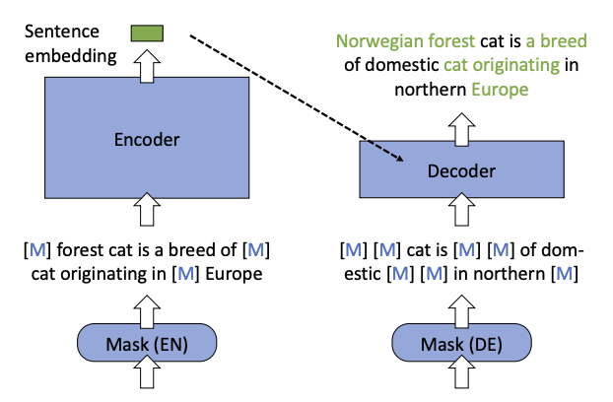
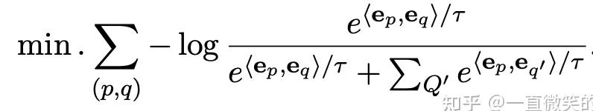
Model Module – BGE Model
Removal of the NSP Task
Eliminated the Next Sentence Prediction task to avoid noise
Integration of the RetroMAE Module
Incorporated the Retrieval-oriented Masked AutoEncoder (RetroMAE) to reconstruct hidden representations
Incorporation of Contrastive Learning

Slide 18
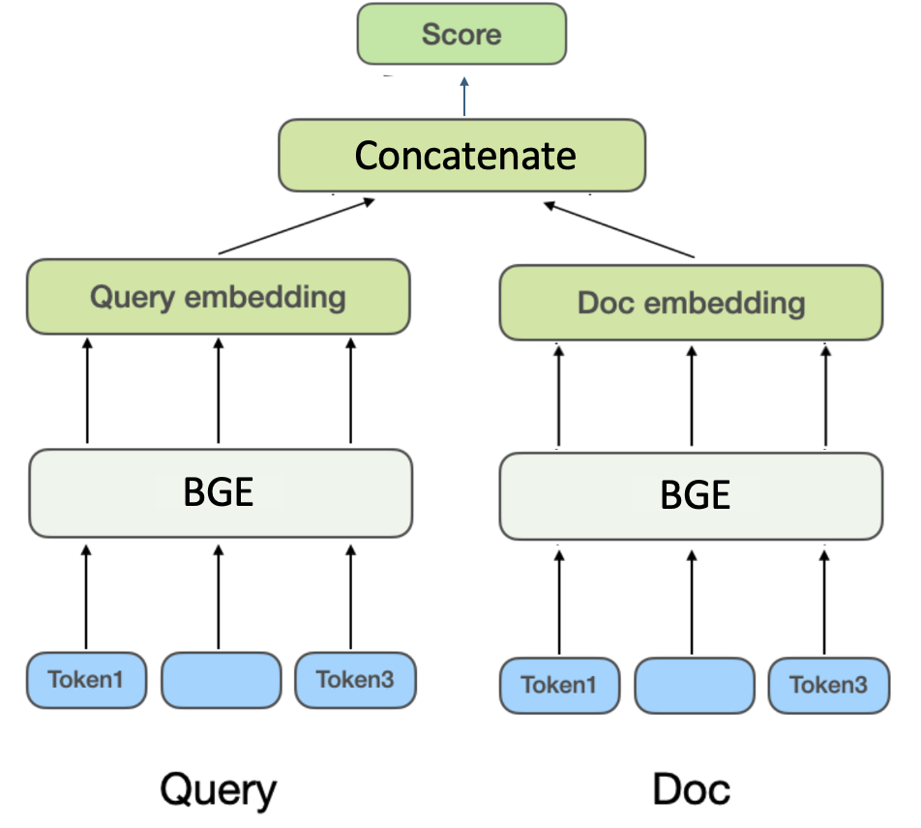
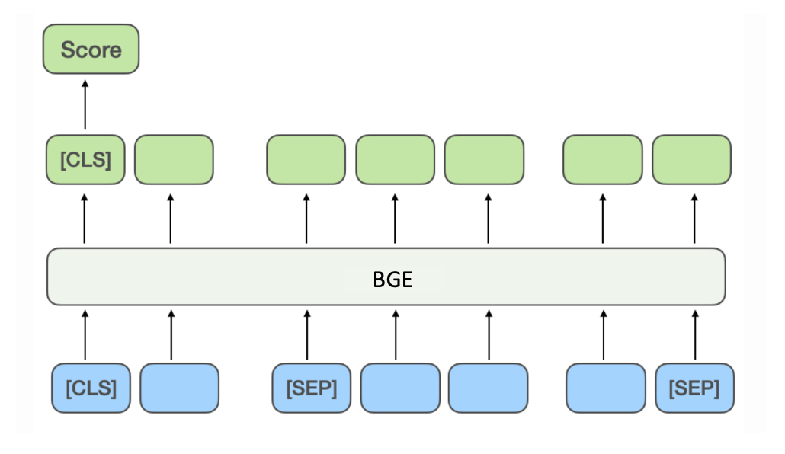

Model Module – BGE Single/Dual Tower Model
Single Tower Model
Dual Tower Model
Query
Document
Query
Document
102,267,648 parameters
Accuracy: 70.20 %
F1-macro: 55.78 %
23,953,920 * 2 parameters
Accuracy : 66.84 %
F1-macro: 50.86 %

Slide 19
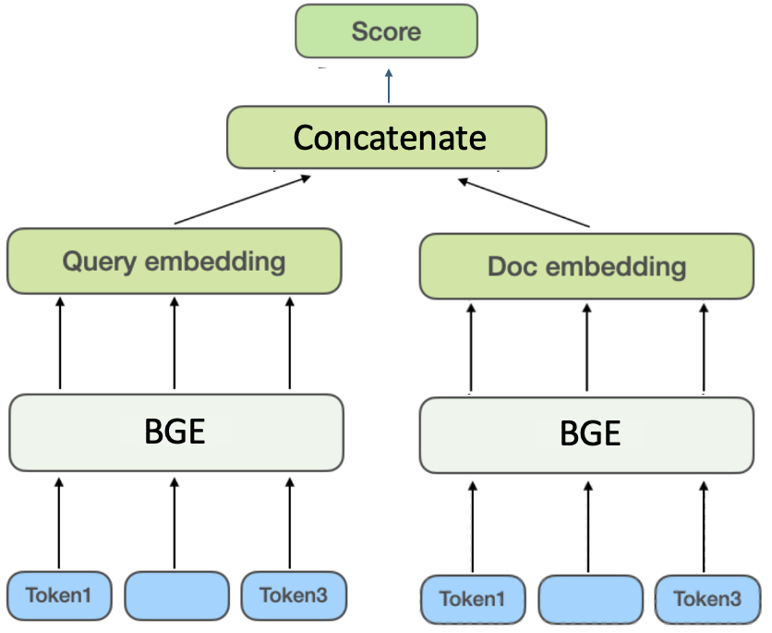
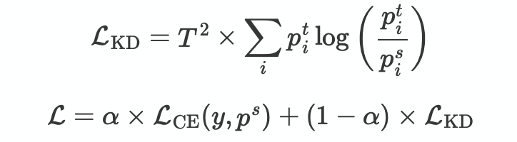
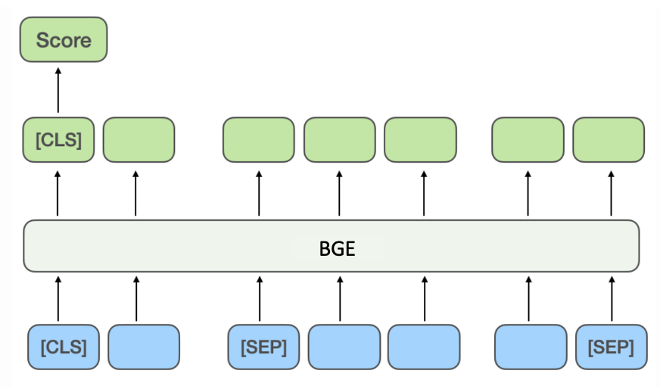

Model Module – BGE Knowledge Distillation
p^{s}= [0.5,0.3,0.2]
P^{t}=[0.2,0.3,0.5]
Student Model
Accuracy : 67.26%
F1-Macro:53.68%
23,953,920 * 2 parameters
Teacher Model
Accuracy : 70.20%
F1-Macro: 55.78 %
102,267,648 parameters

Slide 20
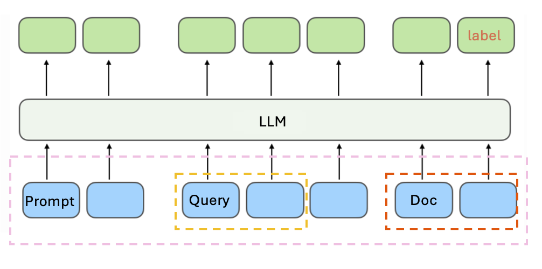
Model Module – Large Language Model
Example
System: You are a search engine. You need to judge the relevance between a given user query and a document.
Score according to the following rules, range 0–2: 0 – Not relevant; 1 – Somewhat relevant; 2 – Relevant. User:
Query:{<Query>} Document:{<Document>} Please give the relevance score (just the number):
Assistant:
1(Label)
Large Language Model(Qwen2.5-0.5B)
Accuracy : 55.48 %
F1-Macro: 43.68 %
494,032,768 parameters

Slide 21
Model Module – Conclusion
Knowledge Distillation
Small student models have limited learning capacity
Large teacher models are much stronger at capturing complex patterns.
By using a large teacher model to perform knowledge distillation, the performance of a smaller student model can be significantly improved.
Large Language Model
When applying LLMs to relevance modeling, their discriminative ability is limited. Since LLMs are primarily designed for text generation, they are not naturally suited for fine-grained relevance tasks. To achieve good performance, LLMs usually require large-scale, high-quality training data.
.

Slide 22

Thanks For Your Attention!

